Slide 1


How to get a website going when JS is not your cup of tea
Alex Drenea
Cloud Solution Architect
Microsoft

Slide 2


Slide 3





State of web development in 2024
React JS
Angular JS
Vue JS
Svelte
jQuery
Javascript
Notes:
What do these have in common?

Slide 4

What is Blazor?
Blazor is a free, open-source, modern web framework
that allows developers to build interactive web UIs
using C#
running server-side on dotnet
or client-side via WebAssembly.

Slide 5
Origins
2017
Blazor first look as an experimental project showcased at a conference
2018
Initial release on .NET Core 3.1 with server-side rendering
Early 2020
Blazor added to the ASP.NET Core mono repo
Mid 2020
Blazor adds WASM support (based on Mono framework)
Late 2023
Blazor 8 is released as part of .NET 8 release

Slide 6
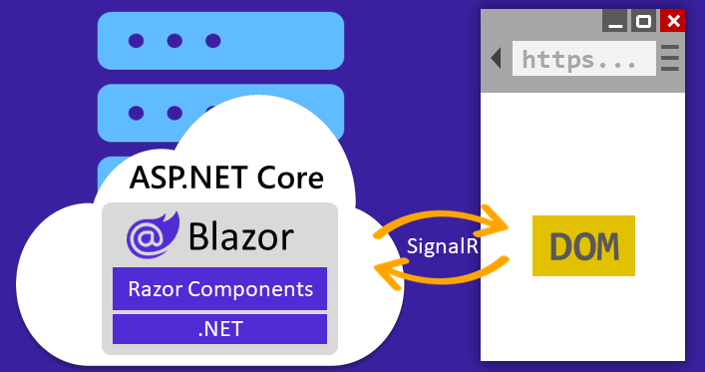
Interactive Server Rendering
Notes:
Benefits:
Download size is significantly smaller than when the Blazor WebAssembly hosting model is used, and the app loads much faster.
The app takes full advantage of server capabilities, including the use of .NET Core APIs.
.NET Core on the server is used to run the app, so existing .NET tooling, such as debugging, works as expected.
Thin clients are supported. For example, Blazor Server works with browsers that don't support WebAssembly and on resource-constrained devices.
The app's .NET/C# code base, including the app's component code, isn't served to clients.
Limitations:
Higher latency usually exists. Every user interaction involves a network hop.
There's no offline support. If the client connection fails, interactivity fails.
Scaling apps with many users requires server resources to handle multiple client connections and client state.
An ASP.NET Core server is required to serve the app. Cannot serve the app from a Content Delivery Network (CDN).

Slide 7
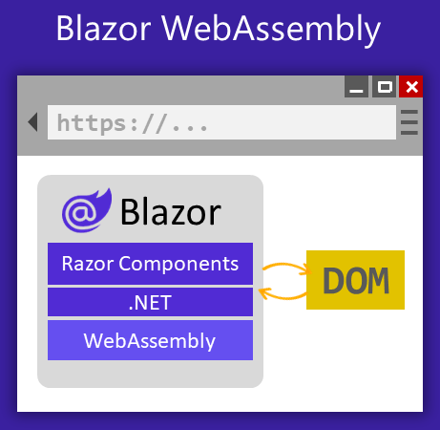
Interactive Client Rendering (WASM)
Notes:
Not all APIs are supported in this mode (this runs a mono version of .NET compiled for WASM and some APIs are missing – list here: https://learn.microsoft.com/en-us/aspnet/core/blazor/fundamentals/?view=aspnetcore-8.0#subset-of-net-apis-for-blazor-webassembly-apps
Benefits:
No .NET server-side dependency after the app is downloaded from the server, so the app remains functional if the server goes offline.
Client resources and capabilities are fully leveraged.
Work is offloaded from the server to the client.
Serverless deployment scenarios are possible, such as serving the app from a Content Delivery Network (CDN).
Limitations:
Razor components are restricted to the capabilities of the browser.
Capable client hardware and software is required.
Download size is larger, and components take longer to load.
Code sent to the client can't be protected from inspection and tampering by users.

Slide 8
Why now?
Static Server-Side Rendering
Streaming Server-Side Rendering
Enhanced navigation and Forms
Auto select render mode at runtime
Page/Component level granularity

Slide 9
Demo
Static Rendering
Notes:
First, what is Static? How is that different than interactive?
Interactivity is everything that the user does on the client side that changes anything on the page (click a button, write text, submit a form, sort a table, add a row, etc)
Open Blazor8-App1
Run app
-

Slide 10
Static Render Modes
Static Server-Side Rendering (Static SSR)
Streaming Server-Side Rendering (Streaming SSR)
Why to use?
When to use?
Notes:
Fast, reliable, scalable, SEO
Static content, that does not change (blog post, product page, etc)
If at this point you are wondering about MVC, I wouldn’t blame you. MVC is also Server Side rendered, but the differences between that and Blazor while subtle, are pretty massive.
First MVC works on full page renders, and the technology behind does not have components like blazor, which makes it harder to reuse. Secondly, any interactivity or “dynamicity” of the page is attained by writing javascript on the client/ which defeats our purpose for this task.

Slide 11







Enhanced Nav (default) / Forms (opt-in)
Prevents a full-page reload when navigating to internal pages
www
Navigate
Fetch
Patch
DOM
Response
Blazor.js
Notes:
https://learn.microsoft.com/en-us/aspnet/core/blazor/fundamentals/routing?view=aspnetcore-8.0#enhanced-navigation-and-form-handling

Slide 12
Demo
Interactive rendering
Notes:
Track:
Open Blazor8-Auto:
With auto mode, we have the ability to write shareable server/wasm components that can work seamlessly across server and wasm.
The big change /difference here is that I don’t have to make this decision at the beginning of my project.
I can choose per component which parts of my app are WASM and which ones are server, alongside SSR
Project walkthrough – we have 2 projects. The client project represents the parts that will be downloaded on the client when needed.
The main project references the client, not the other way around. Components that will be WASM or Auto need to live in the client.
let ‘s look at the counter – counter is interactive auto and lives in the client project.
Run the project, Clear the app cache in dev tools.
Refresh and load the counter page
– notice how the page loads instantly and can use it,
- there are a LOT of files downloaded - all the wasm required for our client project ( debug builds have more files, release is optimized better)
On the ws tab in network inspector, we do have a socket open.
Navigate away from the page
Ws gets closed
Nativate back to counter
Loads instanty
Ws does not get open – running in wasm
Back to the code.
Let’s say we need something a bit more complex than a counter, let’s say we want to make the weather page interactive, and have the data come from a database
Switch to databasecall branch
What did we do here- we just added a service that returns the weather service – imagine this isn’t’ hardcoded and is coming from a db.
Now, we want to make this interactive auto
Based on what we discussed, we would need to put this file in the Client right ?
Let’s do that
Copy weather.razor page in client project
Missing interface… let’s create a services folder in the client and copy the interface
Now what about the service file? Can I put that in the shared project?
If we do, then database connection will have to be in the client – no good
Move the service back to server project
Create new implementation in client
Use API call to get the data and no db
Back to the server project
Expose an API that uses the service to return the data

Slide 13
Interactive Render Modes
Auto
Interactive Server + Interactive WASM
Ability to choose at component / page level not app level
Auto is complex – use it only if you need to
Demo

Slide 14
Rendering Conclusion
With great power comes great responsibility
Notes:
There are a lot of new features and ways you can slice and dice your

Slide 15
Demo
Smart Components
Notes:
https://devblogs.microsoft.com/dotnet/introducing-dotnet-smart-components/

Slide 16
The last question
Surely there must be a trick “You can’t have a nice UI without *any* JavaScript”
And you’d be right, just because I don’t want to write JavaScript doesn’t mean *you* don’t or can’t.

Slide 17









Slide 18
Conclusion
Blazor is ready for you to build real apps on
SSR and Auto modes and the per page settings make it a real candidate for a full-fledged web framework for your website
If you’re on Blazor 6 – take the time to evaluate and upgrade. It’s worth it
Notes:
Blazor is a free, open-source, modern web framework that allows developers to build interactive web UIs using C#.
Blazor supports both server-side and client-side rendering.
Blazor has benefits such as improved performance, reduced complexity, and cross-platform compatibility.
Blazor can be used in a variety of use cases such as line-of-business applications, single-page applications, and progressive web applications.
Blazor has a promising future, with continued development and support from Microsoft.

Slide 19

Q&A
Thank you!
@alexdrenea

